Slide 1
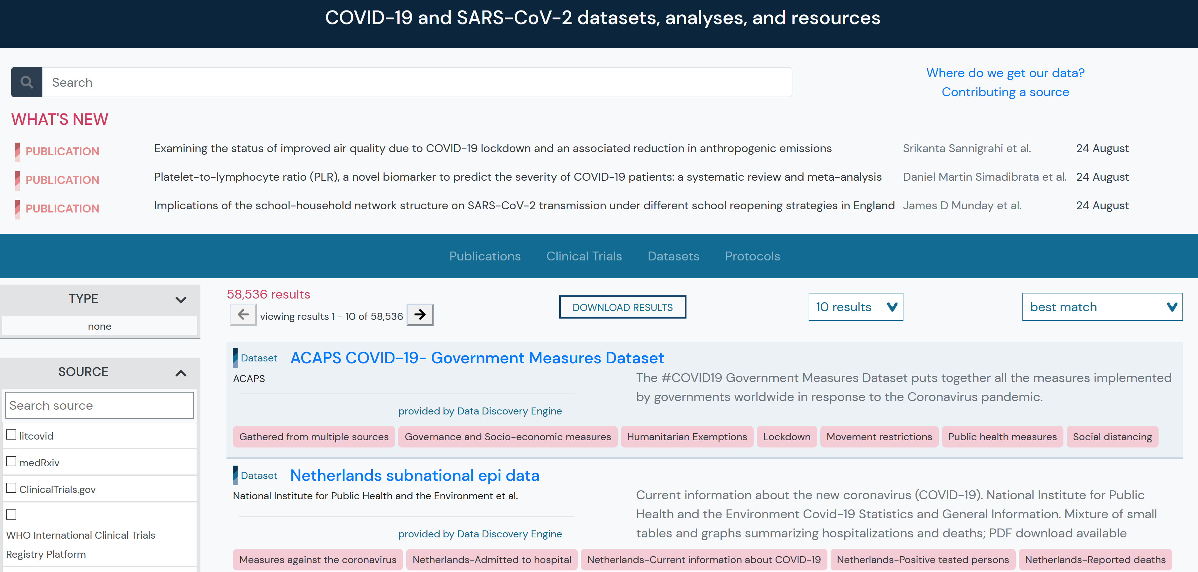
COVID-19 LST
Notes:
COVID-19 LST will be added to our sources panel, which will allow users to restrict the results by source

Slide 2
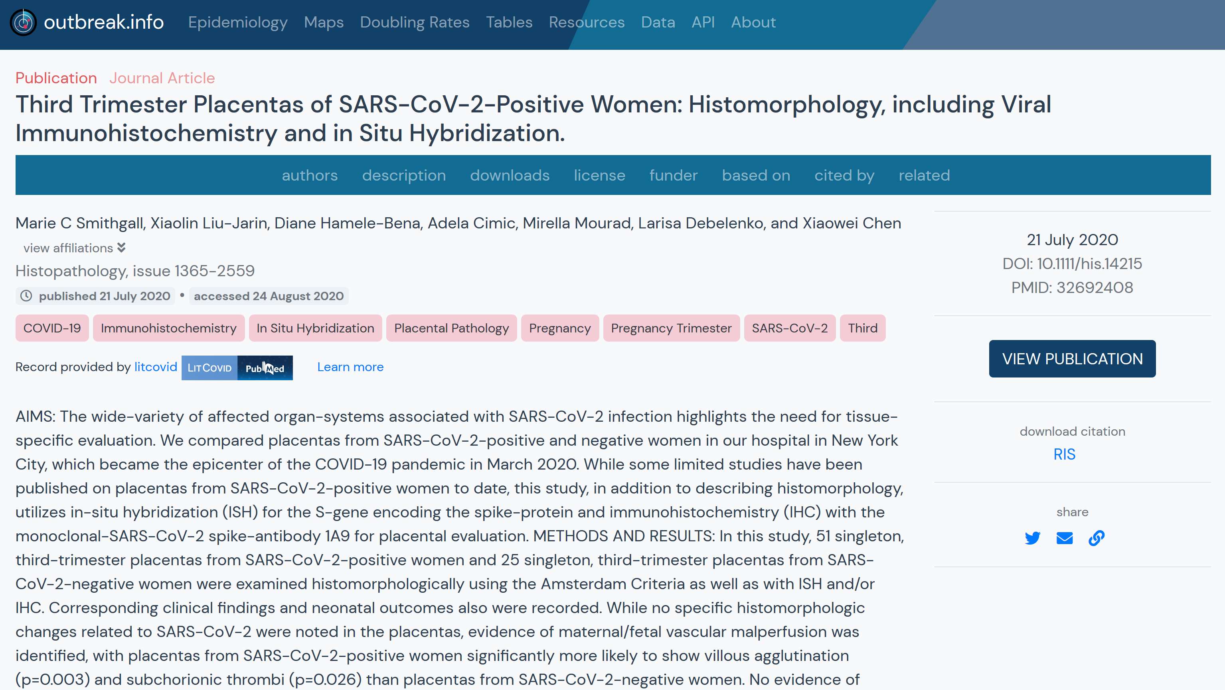

Review
July 21 Daily COVID-19 LST Report
Will Smith, Jasmine Rah, Thamana Nishath, Erin Harnett, Samuel Philbrick, Emily Nelson, Jackson Schmidt, Kealapono Richardson, Michelle Arnold, Brennan Enright, Allison Hansen, Kyle Ellingsen, Zainab Khan, Kathleen Hanlon, Sangettha…
Report authors if available,
if not COVID-19 LST members
COVID-19 LST
Analytical reviews on the level of evidence presented in publications by a team of medical students, PhDs, and physicians. This report specifically covers the following publications: pmid32600909,pmid32692408,pmid32691856…
Link to report
on LST site
Auto generated text based on
pmids for a specific report
Notes:
Each report will have it’s own record, which will include the report authors (if available/preferred)—otherwise the authorship may include all COVID-19 LST members—up to you guys how you want to handle it. Each record will also link to the report url on LST site. The description will be automatically generated based on the pmids in the raw file for the report.

Slide 3
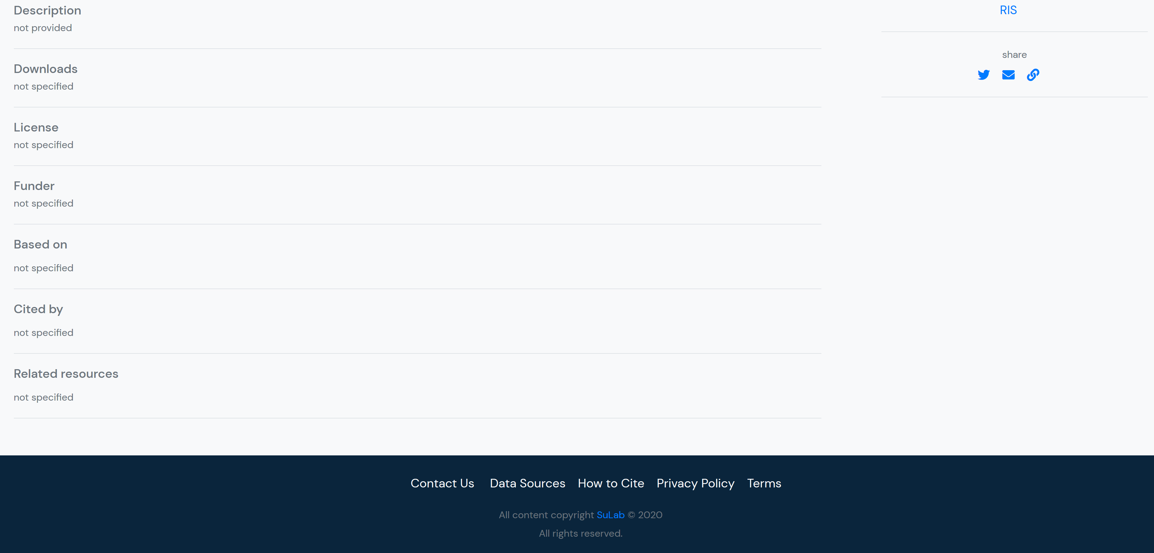
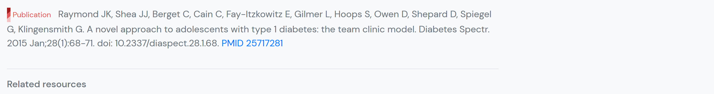
Topjian A, Aziz K, Kamath-Rayne BD, et al. Interim Guidance for Basic and Advanced Life Support in Children and Neonates With Suspected or Confirmed COVID-19 [published online ahead of print, 2020 May 4]. Pediatrics. 2020;e20201405. doi:10.1542/peds.2020-1405 PMID 32366608
Each report will be linked to the publications they discuss
Notes:
Each record will have a reference section which will include the citation for the pmid reviewed in the record

Slide 4
Notes:
Each corresponding pmid should already have a record on our site (since we pull metadata directly from litcovid/pubmed, biorxiv, medrxiv and more

Slide 5
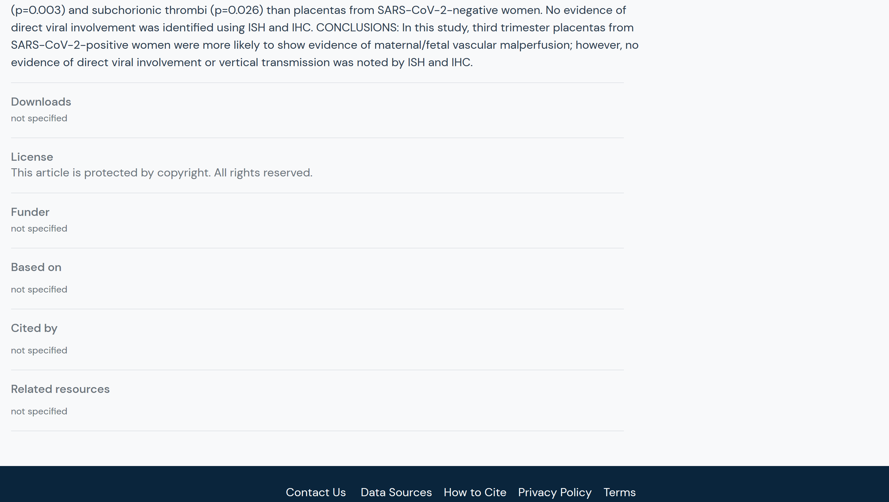
Link to COVID-19
LST report
Covid-19 Literature Surveillance Team. Month XX Daily COVID-19 LST Report. 2020.XX.XX
url: https://www.covid19lst.org/post/month-XX-daily-covid-19-lst-report
Notes:
The corresponding pmid record will be updated with a reference to the covid-19 lst report and corresponding url

Slide 6
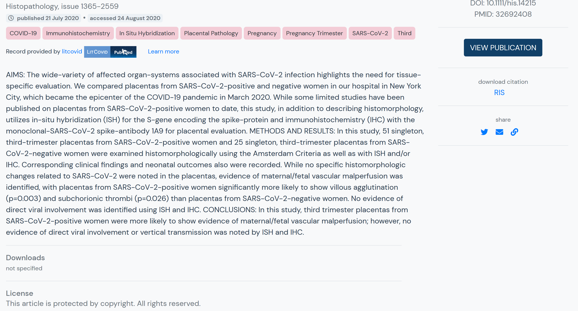
COVID-19 LST evaluation
Level of Evidence: 3
Methodology: Local non-random sample
Report
Teaser info showing value of report,
Link to COVID-19 LST report
Note- layout TBD by viz team
Notes:
Some additional metadata from COVID-19 LST report can be included to illustrate the value of the report and an additional link back to the report. Note, this is NOT necessarily how it may be displayed, as we have dataviz/graph design members on our team who will figure out the best way to include the info.

Slide 7
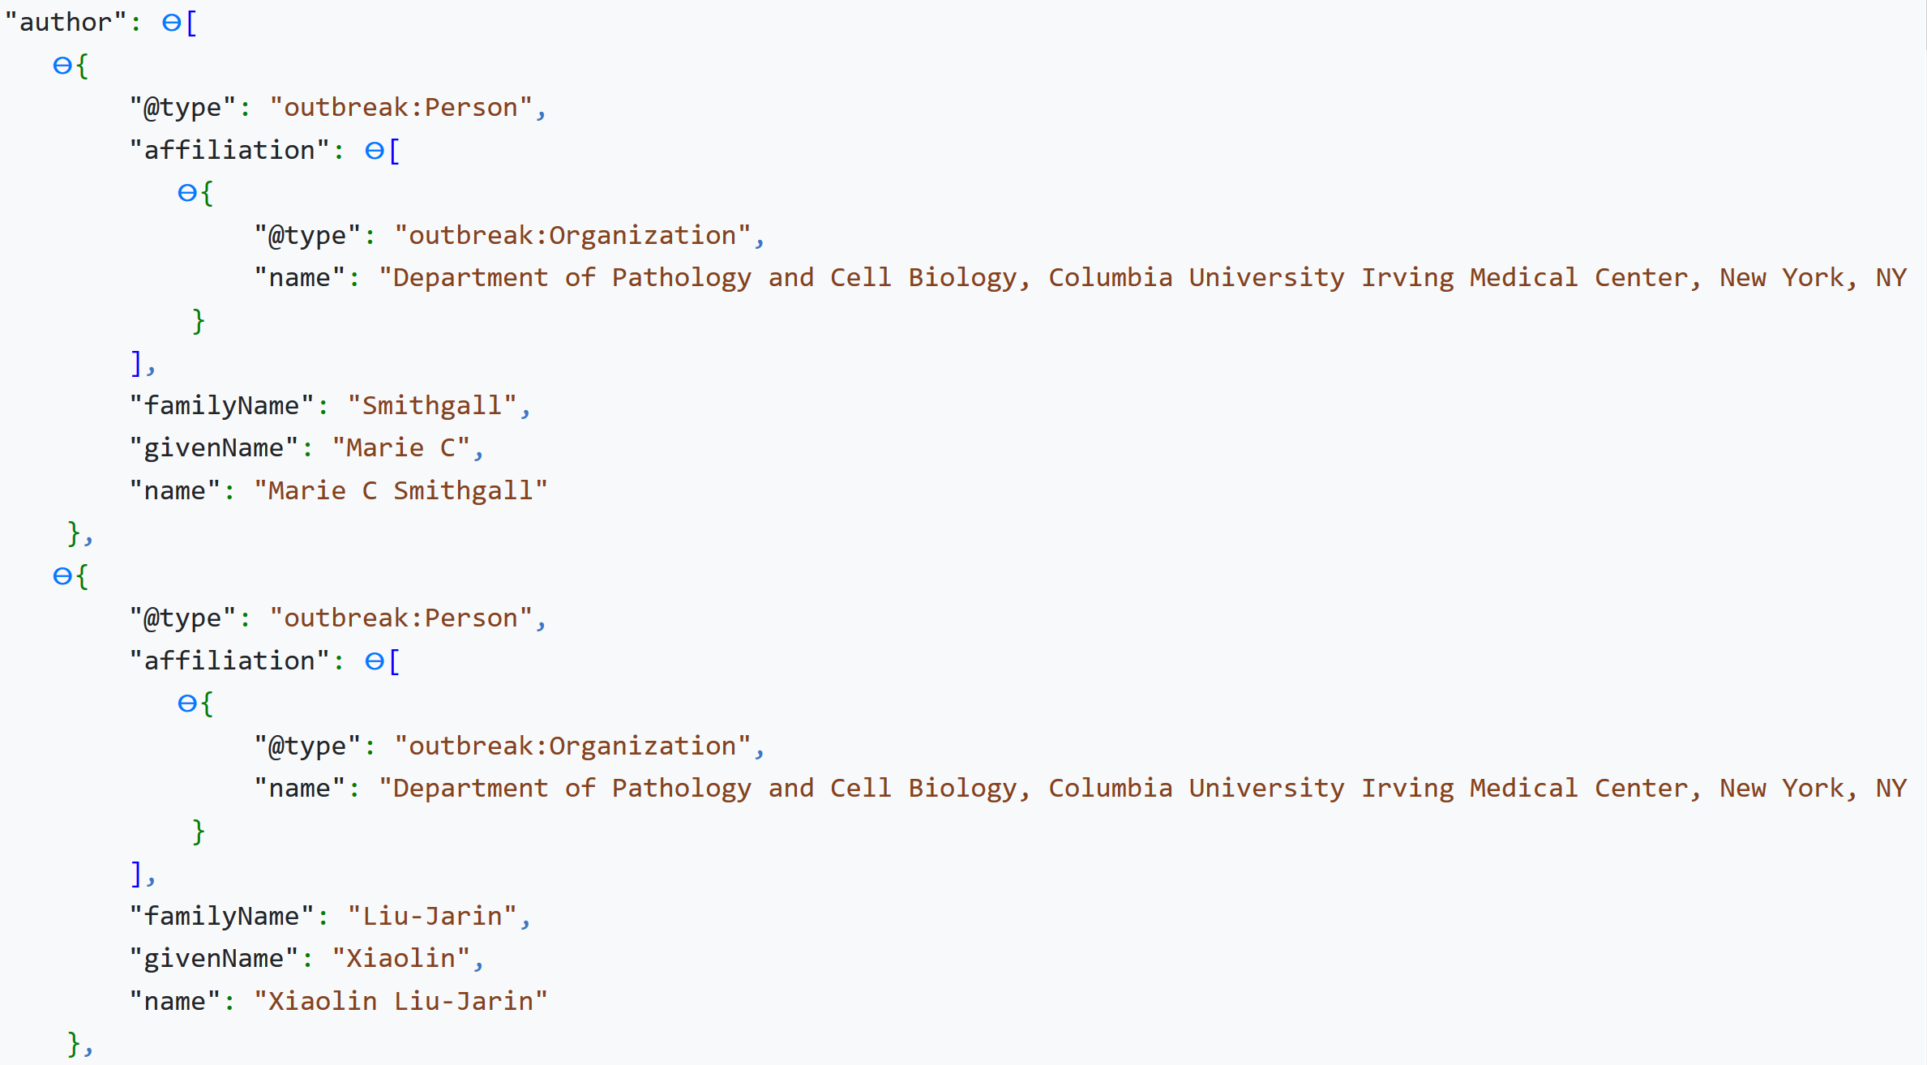
Notes:
The metadata will be stored in json format in our MongoDB database which other people can download. So say, someone builds a publication browser. It would be possible for them to use this metadata to create records (metadata only) for the COVID-19 LST reports and to those records to the appropriate url on the LST site.

Slide 8
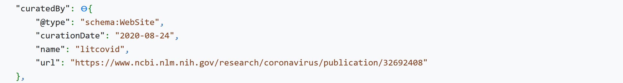
Notes:
This is the bare minimum info for the curatedBy field for litcovid. We can treat COVID-19 LST as a @type of “Organization” and have all the members of the organization listed here. So each individual report could have ‘individualized authorship’, but would be considered ‘curatedBy’ the entire team. Schemas are flexible, so we have options as to how to structure the information.

Slide 9
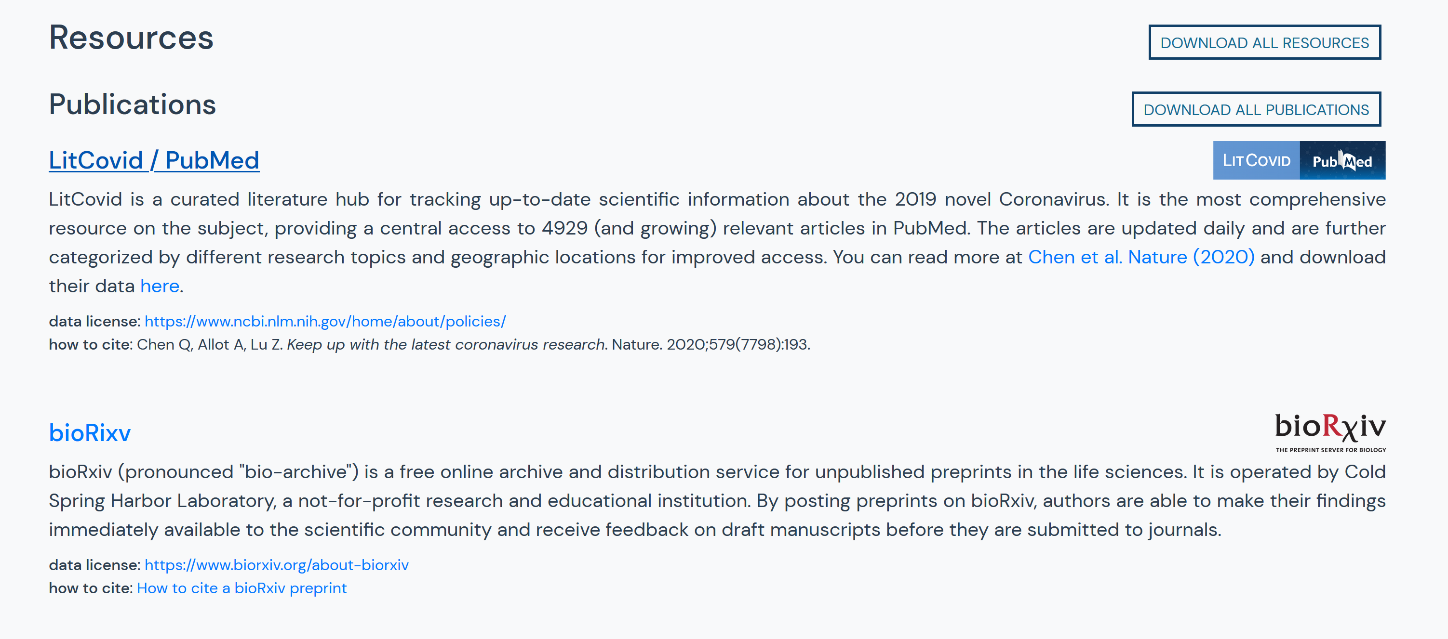
COVID-19 LST
Need a blurb for this
Data license: https://creativecommons.org/licenses/by-nc-sa/4.0/
How to cite: How to cite a COVID-19 LST Daily Report
Notes:
Lastly, we’ll need a blurb to include COVID-19 LST as a source in our data sources section. If you have preferences on how you’d like people to cite a report, we should include that.

